Slide 2
2014 新產品
New PRODUCTS
Isotonix®免疫提升沖飲－橙味
Immune Powder Drink Orange Flavor

Slide 3
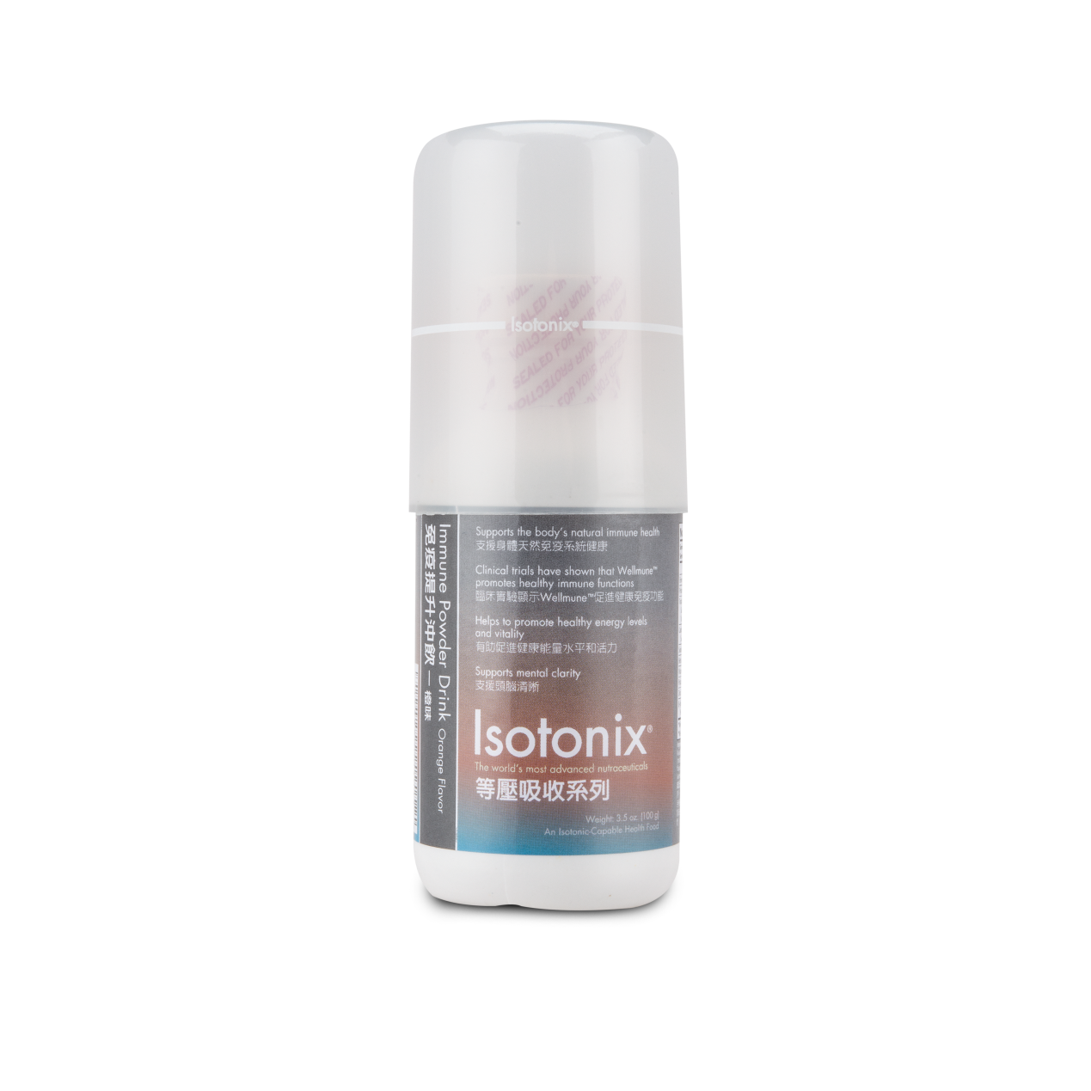
三大免疫元素 Basic 3
Wellmune WGP™
Zn
鋅
Zinc
維他命C
Vitamin C

Slide 4
Isotonix®免疫提升沖飲－橙味 Immune Powder Drink Orange Flavor
有助維持人體天然免疫系統健康
臨床實驗證明Wellmune™可促進免疫功能健康
有助健康能量水平和活力
支援頭腦清晰
Supports the body’s natural immune health
Clinical trials have shown that Wellmune WGP™ promotes healthy immune functions
Helps to promote healthy energy levels and vitality
Supports mental clarity

Slide 5
Isotonix®免疫提升沖飲－橙味 Immune Powder Drink Orange Flavor
HK13984 (30份量 / Servings)
UC: $235.00
SR: $330.00
BV: 23

Slide 6
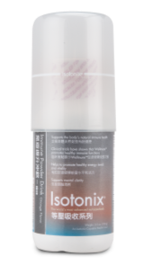
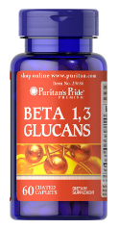
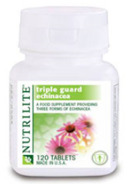
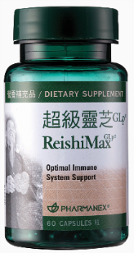
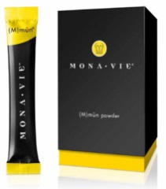
Isotonix®免疫提升沖飲一市場比較 Immune Powder Drink – Product Comparison
 | Isotonix Immune Drink | Puritan’s Pride Beta Glucans | Amway Echinacea | MonaVie (M)mūn® Powder | Nuskin ReishiMax GLP®
等壓傳輸系統 Isotonix Delivery System |  | × | × | × | ×
Wellume™ |  | × | × | √ | √
含維他命C+鋅 Contains Vitamin C & Zn |  | × | × | Zinc only | √
每食用份量零售價 Price Per Serving |  | $4.0 | $13.4 | $25.7 | $34.0
 | Isotonix Immune Drink
等壓傳輸系統 Isotonix Delivery System | √
Wellume™ | √
含維他命C+鋅 Contains Vitamin C & Zn | √
每食用份量零售價 Price Per Serving | $11.0

Slide 7
顧客群 Customers
適合什麼人士呢？
希望促進免疫系統健康
希望優化免疫功能
希望提升健康的能量水平和活力
健康專業人士(HP)
Suitable for people who want to:
Promote immune health
Optimize their natural immune functions
Promote healthy energy levels and vitality
Health Professionals (HP)

Slide 8
健康專業人士計劃 Health Professional Program
健康專業人士使用功效卓越的保健產品支援他們病人的健康
透過實行保健方案，我們亦為健康專業人士帶來額外收入
Leverage the exceptional results of these wellness products to support the health of their patients
By implementing wellness solutions for the patients, we also add ancillary income for the health professionals

Slide 9
首先，讓我們聽聽病人的問題 Let’s start by listening to the questions that patients are asking
｢你有何建議助我更健康？｣
｢你建議我用哪一種綜合維他命、鈣和魚油產品？｣
｢我還有甚麼其他保健方法可以選擇？｣
What do you recommend to help improve my health?
What multivitamin, calcium or fish oil do you recommend?
What healthy alternatives do I have?

Slide 10
美安香港與眾不同 Market Hong Kong Difference
等滲壓營養
吸收效率極高的優質丸狀和膠囊補充品
綜合全面的解決方案
可量度的病人效果
以科學為本的解決方案
讓你有別於其他具相同專長的診所
Isotonic-capable nutrition
High-quality tablets & gel caps that have exceptional absorption rates
Comprehensive solutions
Measurable patient results
Science-based solutions
Setting you apart from other practices of the same specialty

Slide 11
2014 新產品
New PRODUCTS
Skintelligence® Alpha 24
水漾抗皺乳液
Triple Revitalizing Complex

Slide 12
皮膚狀態 Skin Conditions
92%
42% －皮膚缺水 Dehydrate
41%－色斑、暗瘡 Spot & Acne
39%－毛孔粗大 Large pore
35%－皺紋 Wrinkles
25%－皮膚鬆弛 Loosening
8%－沒有皮膚問題 No issues
認為自己皮膚出現
不同的問題 of people complain about skin problems
資料來源Source: 香港大學 Hong Kong University.
Notes:
http://hkupop.hku.hk/english/report/SkinImmunitySurvey/PPT.pdf
http://www.dh.gov.hk/tc_chi/statistics/statistics_hs/files/Health_Statistics_pamphlet_TC.pdf
世界衞生組織建議: 18-64歲成年人應每週進行最少150分鐘中等強度的帶氧體能活動，或最少75分鐘劇烈強度的帶氧體能活動，或相等於混合兩種活動模式的時間。
於二零一二年四月年齡介乎 至 歲之間人士的選定健康
風險

Slide 13
女士在護膚品的花費 Women Spending on Skincare Products
$6800
>$6,000
37%
每年平均花費於
護膚產品上 Average annual spending
on skincare products
資料來源Source: 香港大學 Hong Kong University.
Notes:
http://www.chp.gov.hk/tc/data/1/10/280/1338.html
http://www.dh.gov.hk/tc_chi/statistics/statistics_hs/files/Health_Statistics_pamphlet_TC.pdf
世界衞生組織建議: 18-64歲成年人應每週進行最少150分鐘中等強度的帶氧體能活動，或最少75分鐘劇烈強度的帶氧體能活動，或相等於混合兩種活動模式的時間。
於二零一二年四月年齡介乎 至 歲之間人士的選定健康
風險

Slide 14
對自己的皮膚滿意程度 Satisfaction about Skin Conditions
不知道Unknown
1%
不滿意Unsatisfied
24%
滿意Satisfied
46%
一半半
Half n Half
30%
資料來源Source: 香港大學 Hong Kong University.

Slide 15
美安解決方案 MHK Solutions
√
√
√
√
√
皮膚缺水 Dehydrate
色斑、暗瘡 Spot & Acne
毛孔粗大 Large pore
皺紋 Wrinkles
皮膚鬆弛 Loosening

Slide 16
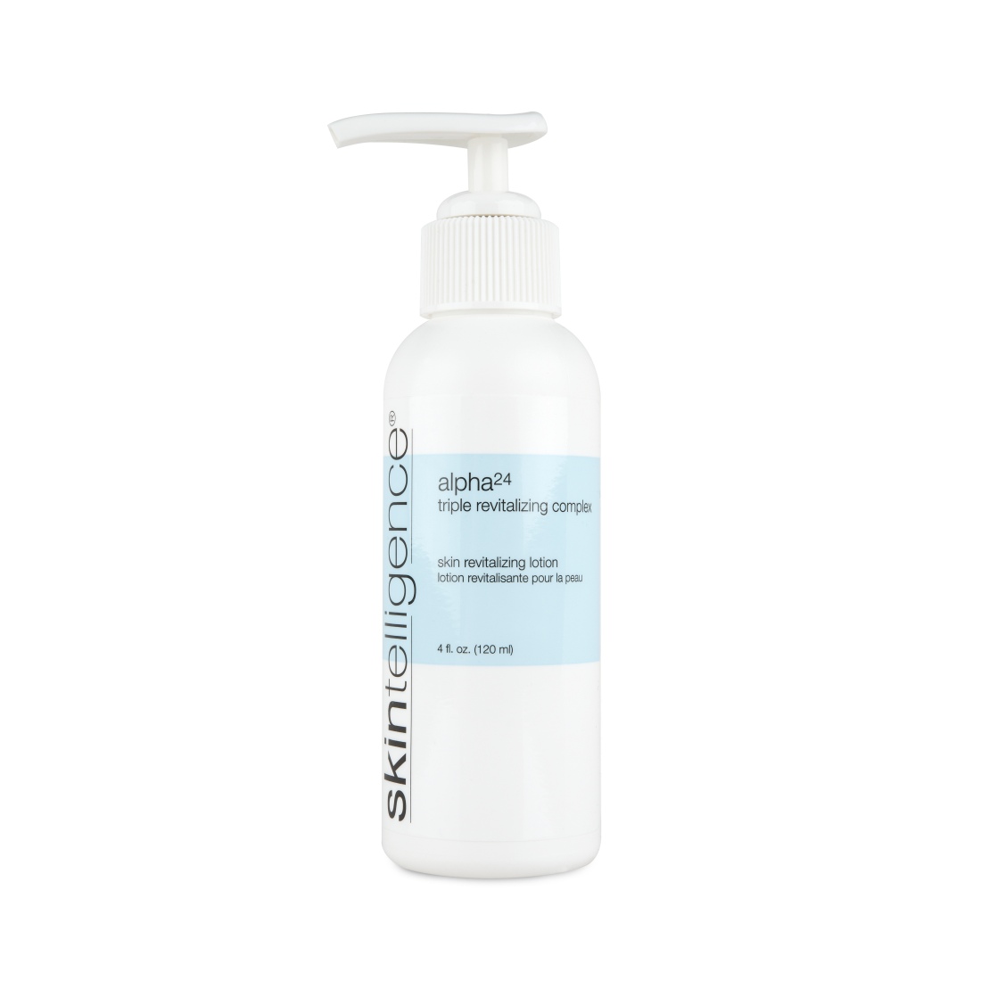
美安解決方案 MHK Solutions
皮膚缺水 Dehydrate
色斑 Spot
毛孔粗大 Large pore
皺紋 Wrinkles
皮膚鬆弛 Loosening

Slide 17
Skintelligence® Alpha 24水漾抗皺乳液 Alpha 24 Triple Revitalizing Complex
主要成份：
混合果酸
洋甘菊萃取物
紫草萃取物
人蔘萃取物
玻尿酸
維他命A、E
Key Ingredients:
Mixed fruit acids
Chamomile extract
Comfrey extract
Ginseng Extract
Hyaluronic Acid
Vitamin A and E

Slide 18
Skintelligence® Alpha 24水漾抗皺乳液 Alpha 24 Triple Revitalizing Complex
主要好處：
減淡細紋及皺紋
提升肌膚保留水分的能力
令肌膚更柔軟
減少膚色不均的情況
Primary Benefits:
Reduces the appearance of fine lines and wrinkles
Enhances skin’s ability to retain moisture
Improves the softness of your skin
Reduces the appearance of skin discoloration

Slide 19
Skintelligence® Alpha 24水漾抗皺乳液 Alpha 24 Triple Revitalizing Complex
HK1275 (120 ml)
UC: $245.00
SR: $350.00
BV: 22

Slide 20
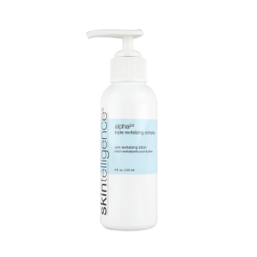
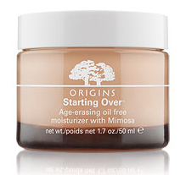
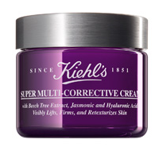
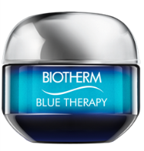
Skintelligence® Alpha 24水漾抗皺乳液一市場比較 Alpha 24 Triple Revitalizing Complex – Product Comparison
 | Skintelligence | Bioderma Matriciane Rides | Origins Starting Over™ moisturizer | Kiehl’s Super Multi-corrective Cream | Biotherm Blue Therapy Age Cream
Alpha 24 |  | × | × | × | ×
保留水分 Retain moisture |  | √ | √ | × | √
減淡細紋 Reduces fine lines |  | √ | √ | √ | √
容量 Volume |  | 30mL | 50mL | 50mL | 50mL
零售價 Retail Price |  | $320 | $540 | $550 | $580
Skintelligence
√
√
√
120mL
$350

Slide 21
2014 新產品
New PRODUCTS
Fixx solution-oriented products®
摩洛哥堅果順髮油
Argan Oil No Frizz

Slide 22
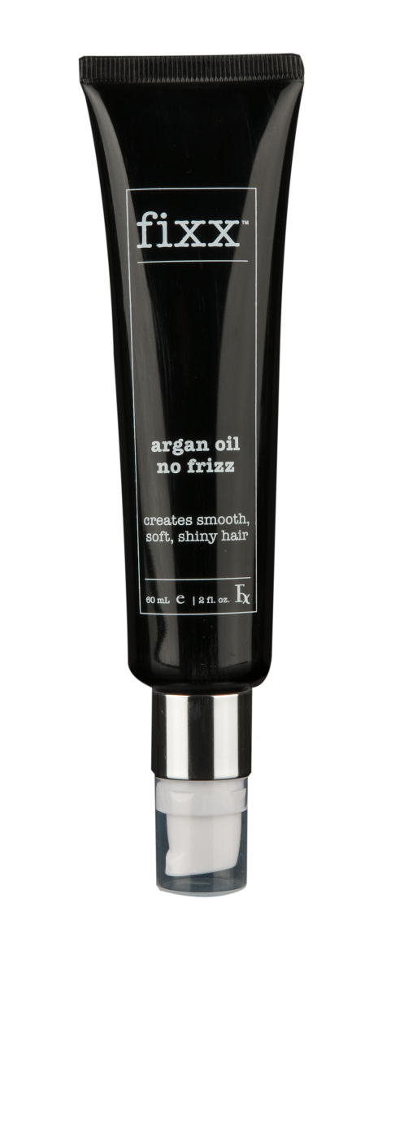
Fixx摩洛哥堅果順髮油 Argan Oil No Fizz
主要成份：
摩洛哥堅果油
亞麻子油
環戊矽氧烷
聚二甲基矽氧烷醇
矽靈
Key Ingredients:
Argan Oil
Linseed Seed Oil
Cyclopentasiloxane
Dimethiconol
Cyclomethicone

Slide 23
Fixx摩洛哥堅果順髮油 Argan Oil No Fizz
主要好處：
撫平毛躁，令鬈髮更分明鬈曲
有助順滑髮絲，令秀髮更豐盈、更有光澤
滋潤和修護頭髮及頭皮
有助提升髮絲彈性，並防止開叉
Primary Benefits:
Controls frizz and adds definition to curls
Helps smooth, shine and add body to hair
Moisturizes and heals your hair and scalp
Helps improve elasticity and prevent split ends

Slide 24
Fixx摩洛哥堅果順髮油 Argan Oil No Fizz
HK12024
UC: $100.00
SR: $140.00
BV: 8.5

Slide 25
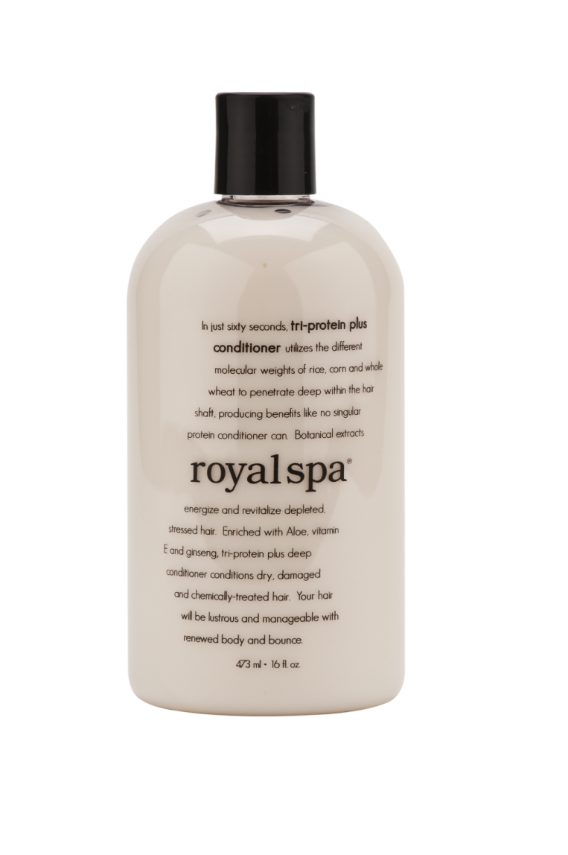
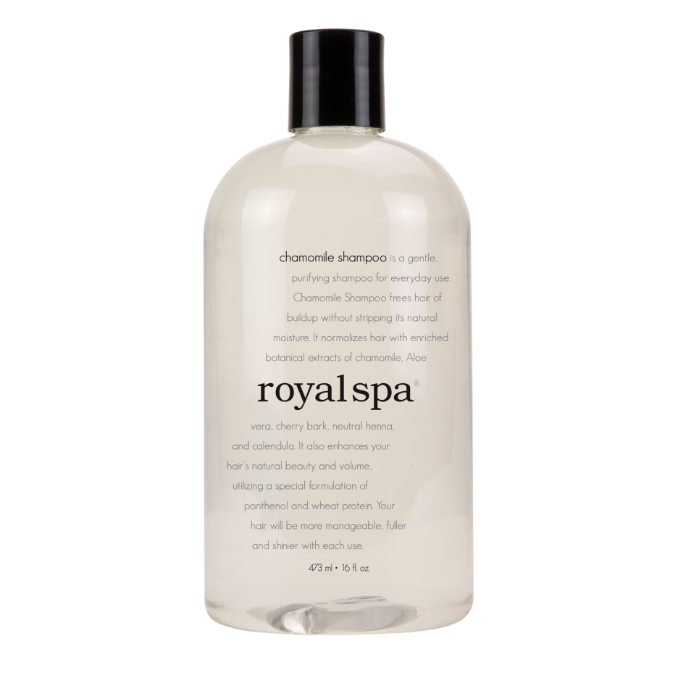
2014 新產品套裝
New KIT
Royal Spa三重護理組合
甘菊洗髮乳
護髮素
沐浴露
15%
Royal Spa 3-Piece Gift Set
Chamomile Shampoo
Tri-Protein Plus Deep Conditioner
Imperial Blend Bath & Shower Gel
HK12024
UC: $245.00; SR: $350.00; BV: 22

Slide 26
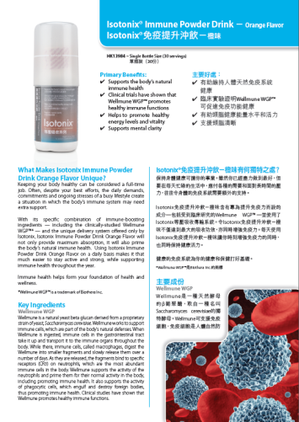
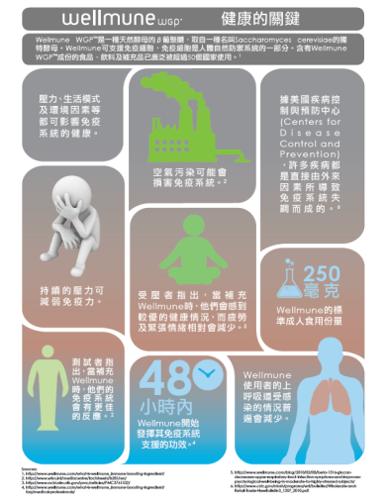
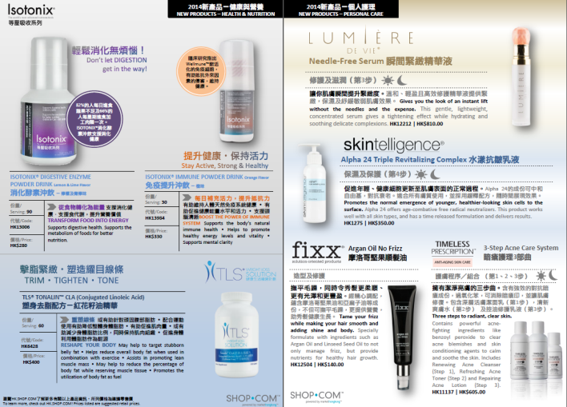
下一步行動 What’s Next?
到超連鎖™管理系統下載單張
Download leaflets at UnFranchise™ System
2. 參與會議聯盟系統一產品訓練
Attend NMTSS Product Trainings
健康與營養
Health and Nutrition
體重管理
Weight Management
化妝品與個人護理
Beauty & Personal Care

Slide 27
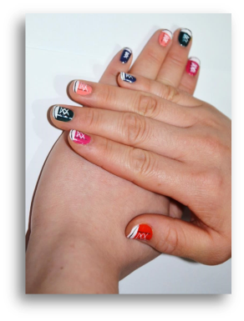
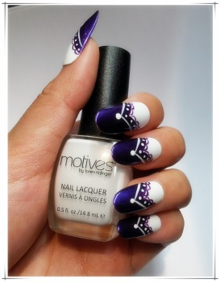
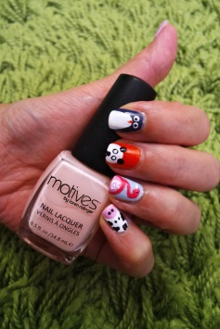
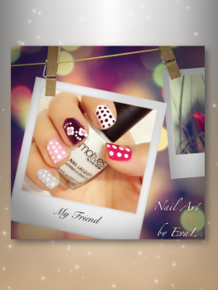
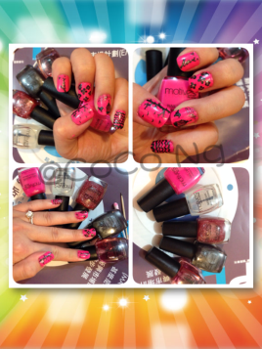
Motives® 持久絕色甲油創意甲藝比賽一最後五強
Creative Nail Art Contest – Top 5 Finalists
到美安香港Motives® by Loren Ridinger 彩妝系列 Facebook專頁一https://www.facebook.com/motivesmhk
挑選及「讚好」 你最喜愛的甲藝作品
*投票截止時間：11月15日晚上11時59分
Visit MHK Motives® by Loren Ridinger Official Facebook Fan Page - https://www.facebook.com/motivesmhk
Select and ‘LIKE’ your favorite Motives® Nail Art
*Deadline for Voting: November 15, 2014 11:59 p.m.
Visit MHK Motives by Loren Ridinger® Official Facebook Fan Page - https://www.facebook.com/motivesmhk
Select and ‘LIKE’ your favorite Motives® Nail Art
*Deadline for Voting: November 15, 2014 11:59 p.m.

Slide 28
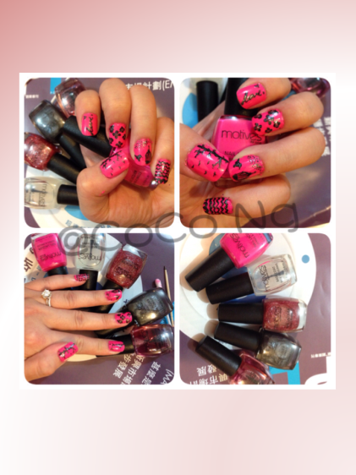
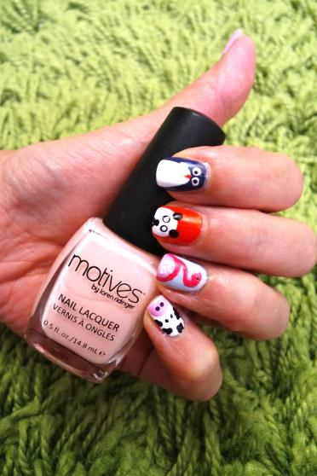
Motives® 持久絕色甲油創意甲藝比賽一最後五強
Creative Nail Art Contest – Top 5 Finalists
Kero Chan
Kenji Cheng
Eva Lau
Coco Ng
Angela Shiu
我的
小鞋子
My Shoes
畫出
漂亮人生
Paint for Life
絕色亮麗
之
婚嫁
Wedding
花語錄
Flowers in the night welcome the pure and cooling rain
小動物・
大世界
Animal World

Slide 29
.
Notes:
29

